Slide 1
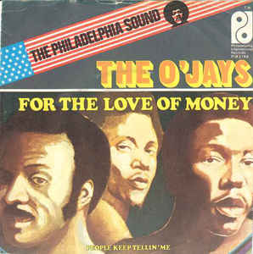
Money, money, money, money…
House Disbursement Data!
Sean McMinn, CQ/Roll Call
@shmcminn
github.com/shmcminn

Slide 2
What is it?
Expenditures paid by members of the House of Representatives out of their Member Representational Allowances (MRAs)
Receipts for how your money is spent

Slide 3
What you’ll find in it
Very exciting data points like postage, members’ dining choices and staff salaries

Slide 4
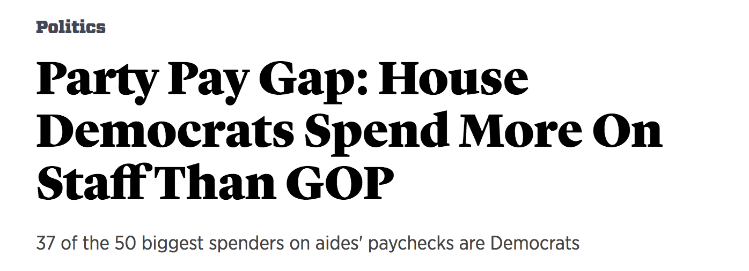

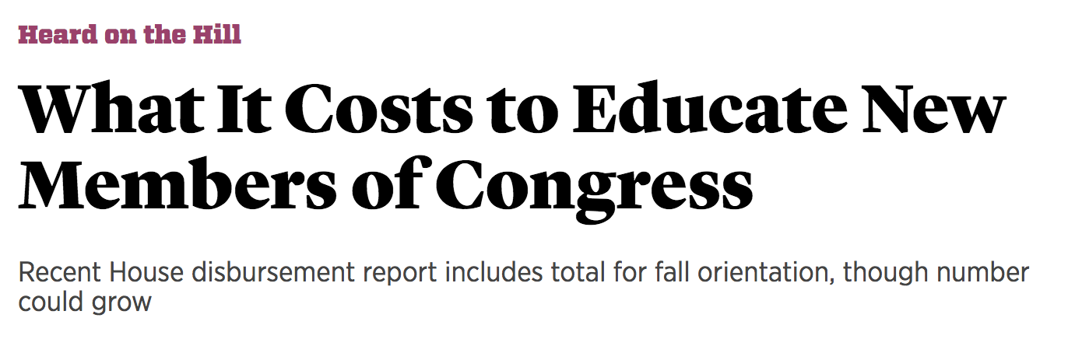
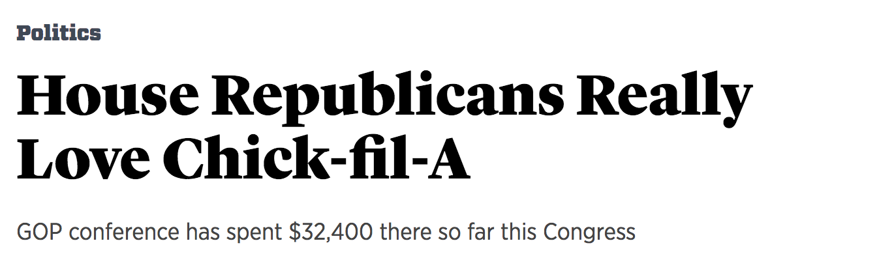

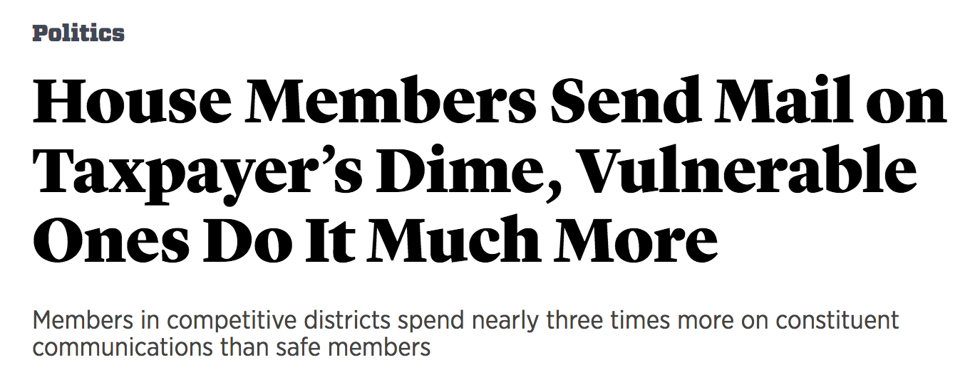
~Exciting~ stories
(#chickfila)

Slide 5
Other story ideas …
How your representative is spending his/her allowance compared to others
How much members take in personal perks, such as travel reimbursement
If your representatives are being as fiscally responsible as they said they’d be during the campaign
If members are “walking the walk” when it comes to paying interns/minimum wages
How big your representative’s office in Washington is vs. their number of district staffers

Slide 6
Warnings
“Detail” file is the one you want, but for some reason (?) it includes “totals” as rows in the middle of the data
Names and descriptions can vary from year to year

Slide 7
How to Access It
disbursements.house.gov for new and archived CSVs
Propublica for historical CSV data scraped from PDFs – shout out to Sunlight Foundation for starting this
Python script to help analyze at github.com/shmcminn/house-disbursements
Please fork and make better!

